Slide 1
Learn JavaScript with fun, build an UFO hunter game HTML and CSS Crash Course - HTML

Slide 2

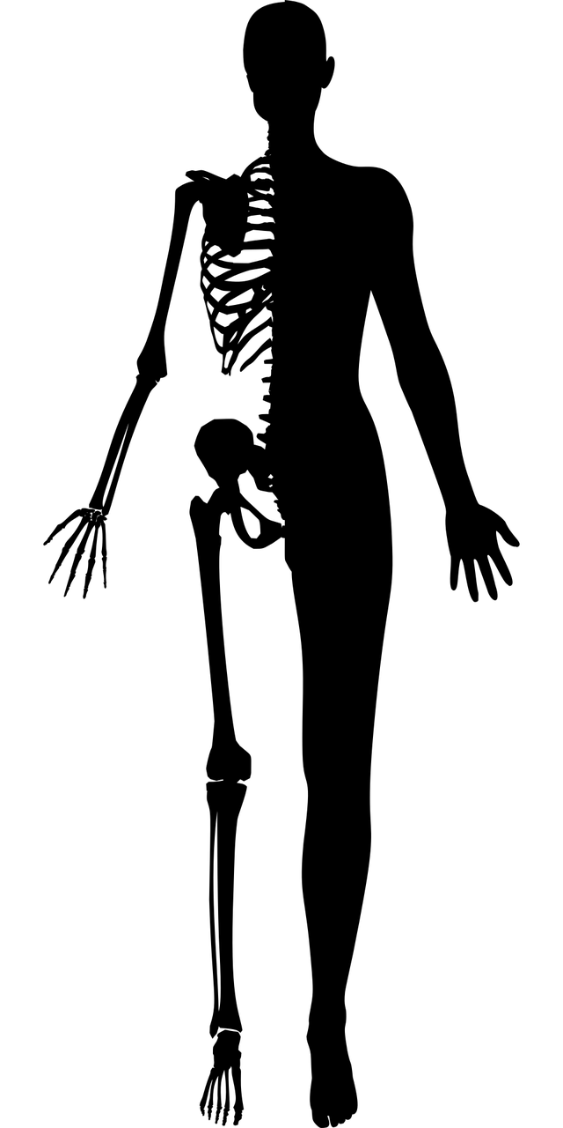

HTML, CSS and JavaScript
HTML
CSS
JavaScript
Structure
Styling, presentation
Functionality, behavior

Slide 3

HTML overview
HTML is not a programming language; it is a markup language that defines the structure of your content. HTML consists of a series of elements, which you use to enclose, or wrap, different parts of the content to make it appear a certain way, or act a certain way. Tags and attributes are the basis of HTML.
opening tag
closing tag
Tags are used to mark up the start of an HTML element and they are usually enclosed in angle brackets.
content
element
Attributes contain additional pieces of information. Attributes take the form of an opening tag and additional info is placed inside.
attribute

